Slide 1

Studio Project
(Final Presentation)
- IoT anyware -
Team Number One (Eagle5)
26th, Jun 2015
Notes:
Hi, My name is Jangsu Lee and I’m the the leader of Team number one. (Nominally)
Now, I want to introduce our “IoT system” to you.
(Even though this project is for study purpose, we regarded this project as an actual thing.)

Slide 2
Table of Contents
Team and Role Assignment
Project Plan
Time Log, Earned Value Management
Architecture Drivers Summary
System Context
Architecture Design
Decomposition & Rationale
IoT System, IoT Server, SA node, User App
Test Results
Lessons Learned
Q&A
Appendix
Notes:
In section one to three (1~2), I will introduce our team and show our planning and doing.
Architectural analysis and design will show in section 3~5.
I will focus on these sections as many time as possible.
I will explain how we tested(validated and verified) our system in section 6.
Finally, I will present “Lessons learned” through this project.
(Finally, you can give us any question after Demo, Please note your question.)

Slide 3






Team Members & Role Assignment
Title
Team Leader / Managing Engineer
Name
Jangsu Lee
Assignment:
- Testing & Management
- Requirement Analysis
- Architecture Design
Mentor :
Daniel Plakosh
Title
Technical Writer /
Requirements Eng.
Title
Chief Architect / Support Engineer
Title
Developer
Title
Developer
Name
Yoonki Hong
Name
Jeonggil Lee
Name
Changwook Lim
Name
Jaehoon Kim
Assignment:
- IoT Infrastructure
- Requirement Analysis
- Architecture Design
Assignment:
- IoT Infrastructure
- Requirement Analysis
- Architecture Design
Assignment:
- SA Node
- Requirement Analysis
- Architecture Design
Assignment:
- User Interface
- Requirement Analysis
- Architecture Design
Legend
Role
Name
Job Assign
Face
Mentor
Order
Notes:
Let me introduce team 1 member’s role.
This is static view. It looks layered pattern.

Slide 4
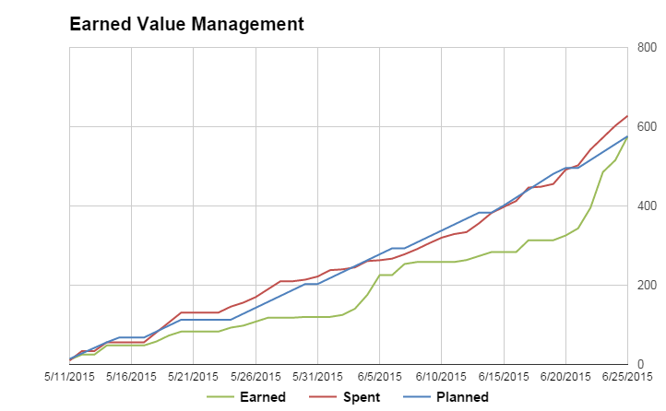
Plan - Earned Value Management
Earned Value | 576
Actual Efforts | 628
+ 52 Hours
Development Period | Day off (Exam, Moving) | Working Day | Actual Effort | # of Person | Day workload per Person
5/11~6/24 (46 Days) | 11 Days | 35 Days | 628 Hours | 5 | 3.58 Hours
Notes:
Actually, we started this project on 5/11 in advance.
We have worked on 35 days.
3.58 (Three and half) hours per person a workday.
Do you agree it is efficient? (efficiency, productivity)
Exam date : 5/29, 6/5, 6/12, 6/19
실측)
여기까지 빨리하면 3분, 여유있게 하면 4분 걸림

Slide 5
Architecture Drivers
< Quality Attributes >
Total | High Priority | Medium Priority | Low Priority
9 | 5 | 4 | 0
ID | Priority | Quality Attribute | Descriptions
QA01 | H | Security | Hackers or malicious people try to break into the system. When unauthorized user attempts to login to the system, the system maintains the audit trail. If the attempt is repeated more than 5 times, the account is locked, and the source of tempering is identified.
QA02 | H | Security | Hackers or malicious people try to register the SA node that is not owned by them. When unauthorized user attempts to register the SA node that he/she doesn’t own, the system maintains the audit trail, and cancels the registration in 10 minutes.
QA03 | H | Availability | SA node can crash, hang, or be disconnected from the network for various reasons. If SA node is inoperable or out of reach, the system should be aware of such events, and notify user within 1 minutes.
QA07 | H | Modifiability | The system should make it easy to add emerging protocols (eg. Bluetooth 802.15, ZigBee 802.15.4) to the system. Average skilled developers should be able to implement it within two months.
QA09 | H | Extensibility | The system should make it easy for application developers (private persons, VARs, or other 3rd parties) to build custom apps, services, and/or make mashups from existing available services. Average skilled developers should be able to build the application in six months.
Notes:
Actually, we started this project on 5/11 in advance.
We have worked on 35 days.
3.58 (Three and half) hours per person a workday.
Do you agree it is efficient? (efficiency, productivity)
Exam date : 5/29, 6/5, 6/12, 6/19
실측)
여기까지 빨리하면 3분, 여유있게 하면 4분 걸림

Slide 6
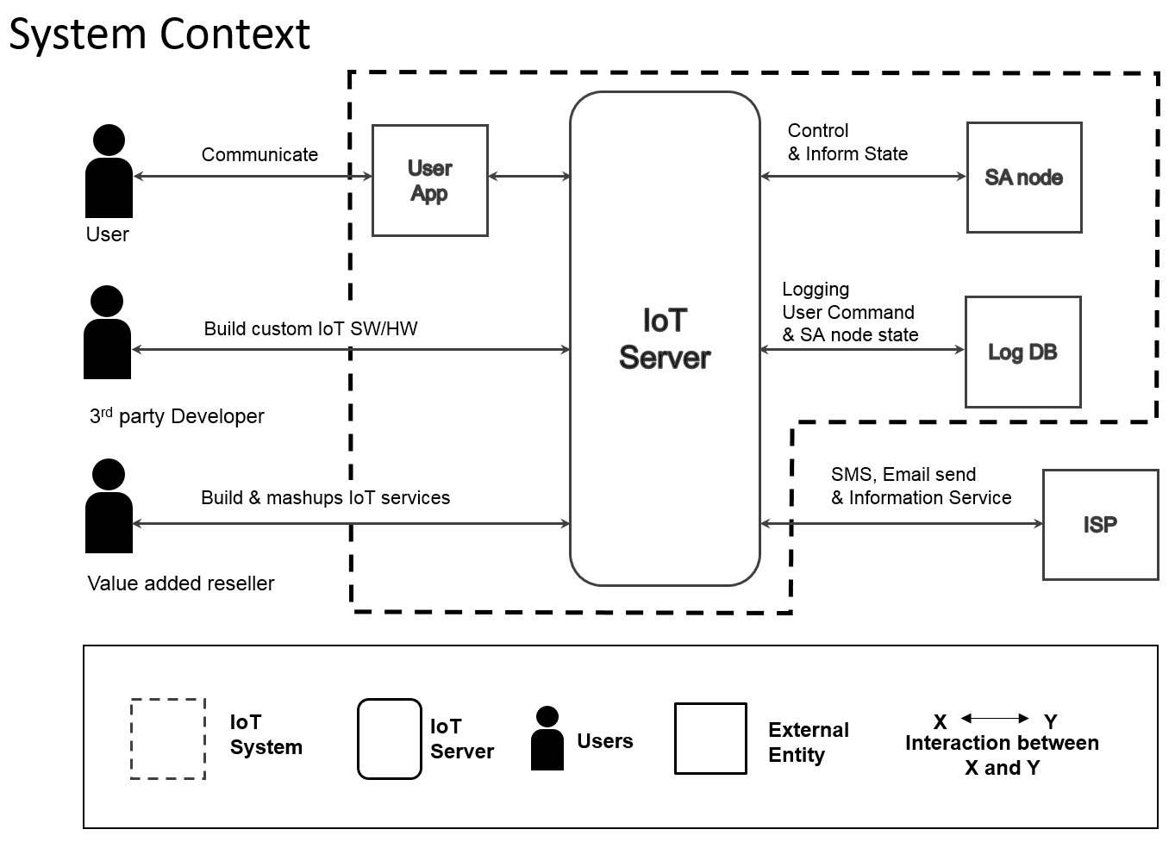
IoT System : Context Diagram
Notes:
After Analysis we(‘d) derived our system context.
This diagram is the first approach of our system design.
We were willing to provide a service for user to interact with their Things. (named as SA node in this project and our system)
And for the extension of our eco system, we provide a kind of SW/HW framework for the developers and open services to other market participants.

Slide 7
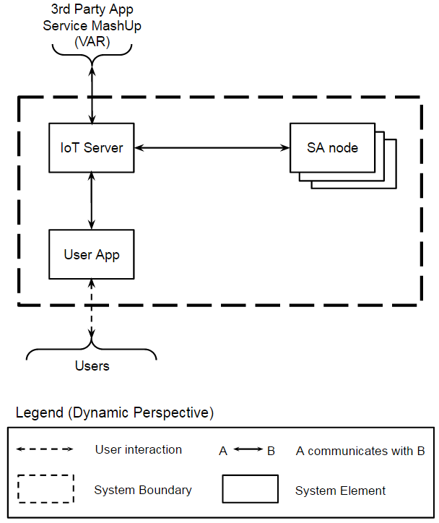
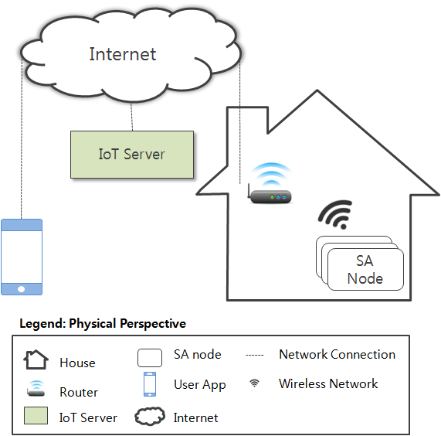
IoT System : Deployment
Notes:
So we break our system to 3 entities(User App for end user, SA node for Things and IoT Server for the service)
They will be located as this picture.(This is an example). It is same with our current system.
But It could be evolved in the future.
So we should consider the evolution of our IoT ecosystem and melt it in our design in advance.(Event bus까지 이어져야 함)

Slide 8
IoT Server : 1st Decomposition (1/2)
< QA09 Extensibility >
Quality Attribute | QA09 Extensibility | Pattern | Publish-Subscribe
Rationale | Loose coupling (vs. Client-Server) Don’t need to know remote elements Easy to add elements
Concern | Performance degradation(Refer to “Performance Experiment”) - Increased network traffic by huge number of SA node Security - Non-trust relationship between publisher and subscriber.
Event Bus
Dynamic Perspective
Legend
A
B
A communicates with B by Event
3rd Party App/Service MashUp (VAR)
Network Connection
IoT Server Runtime
Process
IoT Server Boundary
User App
SA Node
Notes:
<<Rationale>> Extensibility
1) User app and SA node can be easily developed and composed into system without making a lot of sense about system and knowing each other’s identity and existence (Extensibility)
2) User app and SA node can be easily added to the system at runtime without affecting each other and system (Scalability)
3) Also, they can be modified without affecting each other and system at runtime. (Modifiability)
<<Script>>
As I told you, Extensibility is one of the most important QA.
So we considered introducing Pub-Sub pattern to IoT Server.
It is well-known pattern as good on scalability.
But there are some disadvantage to be considered. first is latency, second is delivery

Slide 9
IoT Server : 1st Decomposition (2/2)
< QA03 Availability >
Quality Attribute | QA03 Availability | Tactic | HeartBeat
Rationale | To detect the fault of SA node. To notify failure to User App. To reduce event traffic (vs. Ping/Echo)
Concern | Performance degradation (Refer to “Performance Experiment”) - Workload increasing by Heartbeat event - Network congestion by concurrent generation.
Event Bus
Dynamic Perspective
Legend
A
B
A sends HeartBeat to B
IoT Server Runtime
A
B
A sends failure to B
Process
IoT Server Boundary
User App
SA Node
Notes:
이미 구현되어 있는 Event버스를 활용하여 SA node가 정상적으로 동작하고 있는 동안에 주기적으로 heartbeat으로 간주되는 event를 pub하도록 함.
사용자가 node의 유효성을 확인하는 reasonable한 시간을 30초로 가정하고, heartbeat은 10초 간격으로 pub하도록 함.
동시에 heartbeat를 날리는 것을 최대한 방지하기 위해 각 node는 동작이 시작하면 자신의 MAC정보를 SEED로 생성된 random delay를 갖도록 함.
Extensibility는 유지 되지만
performance가 우려됨.
→ performance 열화 정도를 확인하기 위해 experiments함.
핑에코
extensibility를 위해서 적용한 event버스에 추가적으로 IoT 서버와 SA node간의 network연결이 존재하여야 함. maintainability, modifiability 떨어짐 이것은 Extensibility의 QA를 만족하지 못함.

Slide 10
IoT Server : 2nd Decomposition (1/3)
< IoT Runtime >
Event Bus
Sensor Data Store
User Data
Store
Sensor Data Store
Event
Manager
Web Server
User App
SA Node
3rd Party App/Service Mash-Up (VAR)
Legend (Dynamic Perspective)
Network Connection
A
B
Data Flow
Process
A
B
A communicates with B by Event
RDBMS Database
NoSQL Database
IoT Server Runtime Boundary
Notes:
To help the understanding, IoT Server was decomposed more detail.
Web Server :
User authentication for security
SA node management - registration, unregistration, and sharing
Network communication channel was encrypted by HTTPS
Event Manager :
To make loose coupling to an “Event Bus”, Event Manager shall care the events.
Logging - for scalability log data was stored in NoSQL database
User Data Store / Sensor Data Store :
For sfety from hijack, unwanted initialize by user, and so forth.

Slide 11
IoT Server : 2nd Decomposition (2/3)
< Event Bus>
MQTT Broker
MQTT Proxy
IoT Server Runtime
User App
SA Node
3rd Party App/Service MashUp (VAR)
Legend (Dynamic Perspective)
Network Connection
A
B
A sends event to B
Event Bus Boundary
Process
Notes:
To help the understanding, IoT Server was decomposed more detail.
Web Server :
User authentication for security
SA node management - registration, unregistration, and sharing
Network communication channel was encrypted by HTTPS
Event Manager :
To make loose coupling to an “Event Bus”, Event Manager shall care the events.
Logging - for scalability log data was stored in NoSQL database
User Data Store / Sensor Data Store :
For sfety from hijack, unwanted initialize by user, and so forth.

Slide 12
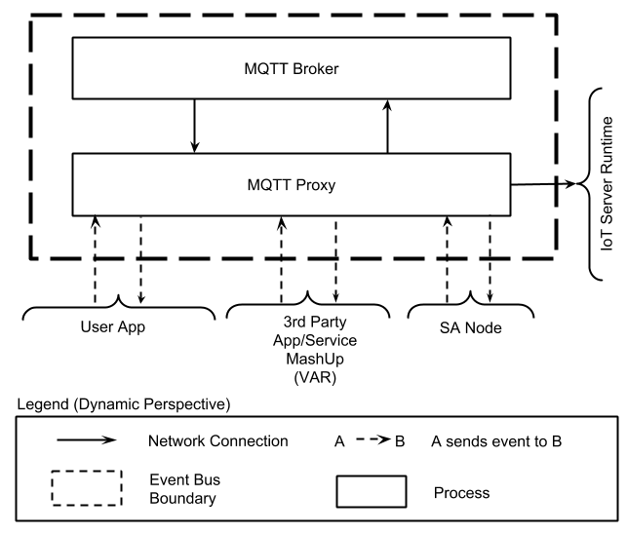
IoT Server : 2nd Decomposition (3/3)
< QA01 Security >
Quality Attribute | Security | Tactic | Authenticate Actors
Rationale | To resist unauthorized access - Account Manager issues Session ID for Event Bus access - Session ID is valid only for limited time period
Event Bus
4
5
Web Server
(Account Manager)
3
6
User App
1
Legend (Dynamic)
2
Application
Process
Control Flow
Notes:
인증된 사용자 만을 IoT시스템에 접속하여 정상적인 동작을 보여주기 위해 우는 IoT서버에 인증 서버를 추가하였다.
인증된 사용자만을 허용하기 위해 web server는 인증 서버로서 event버스에 유효한 session id를 부여하는 책임을 갖는다. (User App, SA node모두 해당)
Event버스는 연결 요청이 올 경우 해당 세션이 유효하지 web server에게 확인후 연결을 수락한다.
웹 서버는 부여한 session ID를 일정 시간 동안만 유효한 값으로 부여하므로, 세션 만료전에 새로운 새션 ID를 부여 받아야 한다.
이는 세션을 일시적으로 도용하여 사용하는 unauthorized 사용자를 방지하기 위한 목적으로 사용된다.

Slide 13
IoT System - Register Sequence Diagram
< QA02 Security >
Quality Attribute | Security | Tactic | Authorize Actors
Rationale | To permit the rights to access SA node by authenticated owner of it - Access control by the lists of User and SA node - Denied of the registration of SA node by non-owner
USER
USER APP
IoT Server
SA Node
1: SA Node register
Enter S/N of new Node
2: Req. SA Node Register
3: Req. to manipulate SA Node
4: Show guide about manipulate
5: Manipulate SA Node
6: Request Connection
7: Response
8: Send S/N
10: Complete Register
9: Response
Notes:
How to know someone is not owner of SA node which try to register?
IoT Server has the user and node data
Identity of registered node
User with ownership node list
When user try to register new node:
User enter the identity of node
IoT Server checking this identity
To accept multi-use, owner can sharing the SA node to others

Slide 14



IoT System - Physical Perspective
< Availability >
Quality Attribute | Availability | Tactic | Passive Redundancy
Rationale | To be recovered from the redundant spare Zone, when IoT Server doesn’t work Switchable two Zones with periodic database updates
HTTPS
ports 443
gunicorn 19.3.0
WSGI
flask 0.10.1
mysqld 5.5.43
flask 0.10.1
flask 0.10.1
Web Browser
User App
flask 0.10.1
HTTPS, MQTT
MQTT
ports 1883, 8080
mosquitto 3.1
mongod 2.4.9
INTERNET
Ubuntu Server 14.04 LTS / Zone A
HTTPS,
MQTT
Firewall
Ubuntu Server 14.04 LTS / Zone B
Legend (Physical Perspective)
Server machine
User machine
Communication
protocol
Load balancer
Server software running on a machine
SA node

Slide 15
SA node - 1st Decomposition
< QA09 Extensibility >
Quality Attribute | Extensibility (Portability) | Pattern | Layer
Rationale | Easy to port SA node program to various hardware - Extension of Hardware Abstract Layer of SA Controller
SA Manager
SA Controller
(HAL)
SA Network Manager
Arduino Driver
MQTT Adaptor
Legend(Static Perspective)
Middleware Layer
A
B
: A is allowed
to use B
Abstract Layer
Concrete Layer

Slide 16
SA node - 2nd Decomposition
< QA07 Modifiability >
Quality Attribute | Modifiability | Pattern | Light Weight Broker
Rationale | Easy to add the emerging network protocol. - Extension of Emerging Protocol Bridge. - Mediation of Network Broker.
SA Network Manager in Master SA node
(WIFI and Emerging Protocol)
SA Manager
Network Broker
Slave
SA node
(Emerging Protocol)
Publish-Subscribe
Interface
Emerging Protocol
Bridge (e.g BT)
User App
MQTT Adaptor
Legend(Dynamic Perspective)
Module
Instance
A
B
: A call B
SA Network Manager Boundary
A
B
: A communicates with B
by Event
: Emerging Protocol

Slide 17
User App - 1st Decomposition
< QA09 Extensibility >
Quality Attribute | Extensibility | Pattern | MVC
Rationale | Easy to add new View - Hide the interaction between View and IoT Server Easy to reuse Controller and Model for new View.
<<Observe>>
View
Controller
Model
User Interaction
Web
Server
Event
Bus
Legend (Dynamic Perspective)
User App boundary
Network Connection
A
B
A observes B
A
B
A sends a event/message to B
A
B
A updates the B’s data
Run time object
User interaction

Slide 18
User App - 2nd Decomposition
Quality Attribute | Extensibility | Pattern | Object Oriented
Rationale | Easy to add new SA node Easy to modify for changing of IoT Server - Adaptor Pattern(Server Interface/HTTP Adaptor)
View Pkg
User Interface
Control Pkg
Model Pkg
<<interface>>
Server
Controller
Model
SANode
SANode
Node
HTTPRESTClient
HTTPAdaptor
MQTTClient
SensorActuator
SensorActuator
SensorActuator
SensorActuator
Legend (Static Perspective)
Class
A
B
A associates with B
A
B
A specializes B
Package
A
B
A uses B
A
B
A implements B

Slide 19
Test Cases
TB (Test Basic) | TC (Test Complex) | TN (Test Negative) | Total
10 | 7 | 4 | 21
No. TB-03 | SA node register
Relevant Function Requirement Quality Attribute | FR08 : Register SA nodes QA02 : Security – Unauthorized SA node register
Pre-Condition | User is aware of Serial Number of SA node. SA node is not registered in advance. User logged into the server in advance.
Test Procedure | 1. Make sure logged into the server in advance. 2. Select “1.Register SA node” menu. 3. Input [nodeID]/[nickname], then press “Enter” 4. Manipulate SA node to register within 10 minutes.
Pass/Fail Criteria | Pass: (1) SA node is registered successfully. (2) App notifies the node is registered. (3) App shows updated node list. Possible Failures: (1) nodeID is registered already to the server. (2) SA node is not registered to the server within 10 minutes.
Test Results
Notes:
이전까지 12분
To verificate and validate IoT System.
We set test plan and derived total 21 test cases.
They were categorized into 3 parts (Basic, Complex, Negative).
We specified which FR,QA are related this test case.

Slide 20
Test Results (1/2)
ID | Description | Relevant FR, QA |  | Pass | Fail
TB-01 | Register new user account | FR01 | QA01, QA02 | O
TB-02 | Log into the IoT server | FR01, FR02 | QA01 | O
TB-03 | SA node register | FR08 | QA02 | O
TB-04 | SA node unregister | FR09 | QA02 | O
TB-05 | Update SA node status | FR03 |  | O
TB-06 | Determine sensors(Humidity/Temperature/Presence) | FR03 |  | O
TB-07 | Turn on/off the light | FR03 |  | O
TB-08 | Open/close the door | FR03 |  | O
TB-09 | Set/Get log configuration | FR04 |  | O
TB-10 | View log | FR04 | QA03 | O
Notes:
Complex tests are related with Functional requirement also.
Negative tests are Especially related with Quality attribute.

Slide 21
Test Results (2/2)
ID | Description | Relevant FR, QA |  | Pass | Fail
TC-01 | Turn off light automatically | FR07 |  | O
TC-02 | Send emergency message | FR05 |  | O
TC-03 | Lock house automatically | FR06 |  | O
TC-04 | Lock house and turn off light automatically | FR06, FR07 |  | O
TC-05 | Mail box register | FR03 |  | O
TC-06 | Unlock door while alarm is set | FR08 |  | O
TC-07 | Mail box notification | FR05 |  | O
TN-01 | Notify SA node unavailability |  | QA03 | O
TN-02 | Authentication fail |  | QA01 | O
TN-03 | Log into server again |  | QA01 | O
TN-04 | Register unproved SA node |  | QA02 | O
QA01 - Security : Authentication & Authorization
QA02 - Security : Unauthorized SA node register
QA03 - Availability : Notify unavailability to user
Notes:
Complex tests are related with Functional requirement also.
Negative tests are Especially related with Quality attribute.

Slide 22


Lessons Learned
☞ Do not mix the perspective
- We’ve met communication fail with others before
☞ Experiment is very important
- How to know QA of event bus if you don’t know
- How to know what is SA node if you did not use it before
☞ Architectural documents keep matched with real design
- There is no meaning if it is not matched
☞ We MUST consider the Quality Attribute
- Functional requirements is not all for design
- We were not able to tracking the modification reason
Notes:
Deep Sea is comfortable to us still
Expression in English
Mixed perspective ( 창욱C한테 팔 거)
Why experiments is importants? if we don’t know the domain and experience, we can’t care the quality attribute correctly (properly).
How to know QA of event bus (performance and extensibility, and so forth) if we don’t know it
How to know what is SA node, we don’t use it before.
When we do experiments or make a prototype, it is not became a final. Because architecture design decision is not matched with them, it just an experiments without any QA concerning.
I found why I difficult to communicate with other person like marketing guy and even SW developers. The reason is that I mixed the perspective so it causes an confusion.
임창욱
a. Architecture is mainly influenced by Quality Attribute. I mainly decided the design by the functional requirement.
이정길 (engineer’s poor communication skill, 한번 만들어진 API/Interface는 변경하는 것이 어렵다)

Slide 23

Q&A
Notes:
Ask if there are any questions about our Studio project or IoT system.
Please give our colleagues a chance to answer the question.

Slide 24
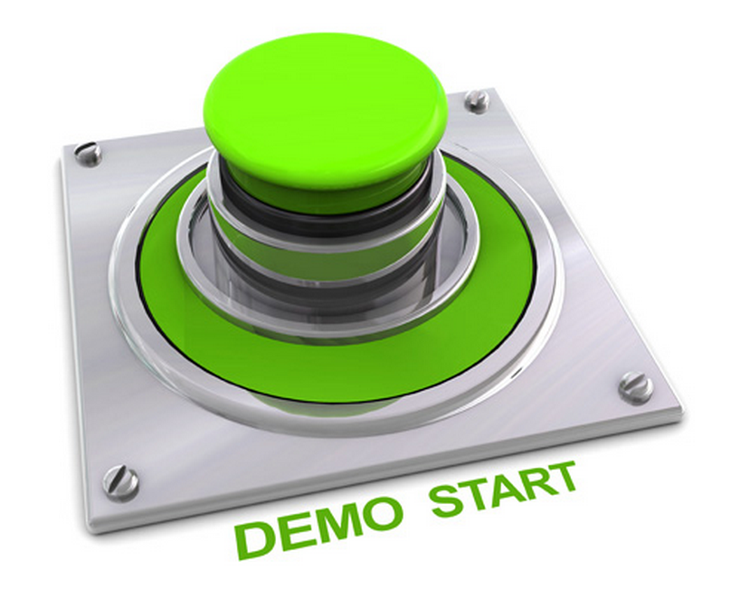
Let’s Start DEMO
Notes:
(18분안에 presentation 완료)

Slide 25
Contents of Appendix
Appendix A - Experiments (Event Bus)
Appendix B - Decomposition of Web Server
Appendix C - Decomposition of Event Manager
Appendix D - Static Perspective of IoT Server
Appendix E - Sequence Diagram(Make Account and Login)
Appendix F - Dynamic Behavior of User App
Appendix G - QA Scenario

Slide 26
Appendix A - Event Bus Experiment (1/3)
Test Environment
AWS EC2 Instance (m3.medium)
OS: Ubuntu 14.04.2 LTS (GNU/Linux 3.13.0-48-generic x86_64)
CPU: 1 x Intel(R) Xeon(R) CPU E5-2670 v2 @ 2.50GHz
MEM: 3.75GB
Configuration Tuning
/etc/sysctl.conf
/etc/security/limits.conf
net.ipv4.ip_local_port_range = 1024 65535 net.ipv4.tcp_tw_reuse='1' # enable reusing socket in TIME_WAIT state net.ipv4.tcp_fin_timeout = 10 # decrease time for socket to stay in TIME_WAIT state net.ipv4.tcp_rmem = 4096 16384 3355443 # TCP Read Buffer size net.ipv4.tcp_wmem = 4096 16384 3355443 # TCP Write Buffer size
* soft nofile 1048576 * hard nofile 1048576

Slide 27
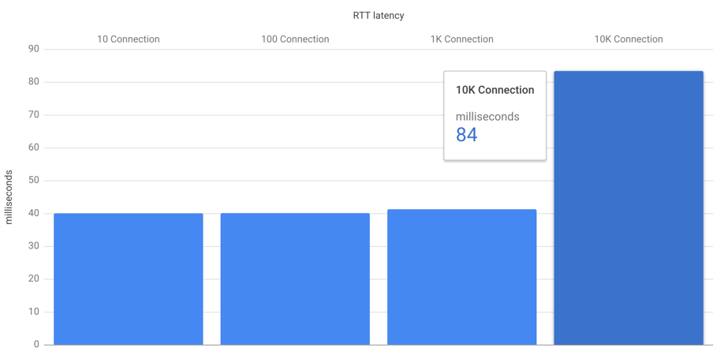
Appendix A - Event Bus Experiment (2/3)
Pre-condition | N. of virtual SA nodes are being connected to the Event Bus. They all are sending Heartbeat event every 10 seconds.
Test Scenario | User App sends the control event to a SA node and receives the status event from it.
Measurement Matrix | X-axis : N. of connections Y-axis : t4 - t1
Result | Max 1000 SA nodes do not effect on performance.
Workload Generator
Event Bus
t1
t4
t3
t2
User App
SA Node

Slide 28
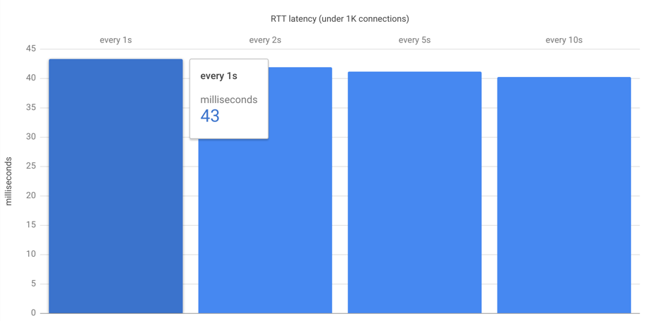
Appendix A - Event Bus Experiment (3/3)
Pre-condition | 1000 virtual SA nodes are being connected to the Event Bus. They all are sending Heartbeat event every N seconds.
Test Scenario | User App sends the control event to a SA node and receives the status event from it.
Measurement Matrix | X-axis : N sec cycle. Y-axis : t4 - t1
Result | Min 10 sec cycle Heartbeat does not affect the performance
Workload Generator
Event Bus
t1
t4
t3
t2
User App
SA Node

Slide 29
Appendix B - Decomposition of Web Server (Dynamic Perspective)
SMTP Service
Sensor Data Store
Log Viewer
Auth Manager
User Data Store
User App
SA Node
3rd Party App/Service MashUp (VAR)
Legend (Dynamic Perspective)
Network Connection
A
B
Data Access
Process
Web Server Boundary
External Service
Notes:
사용자에 대한 인증, SA Node 관리와 Log에 대한 조회는 서로 다른 Workload의 특성을 갖고 있기 때문에 해당 기능을 처리하는 모듈을 분리합니다. Log 조회는 1) 단방향으로 처리되는 Event가 아니라 응답이 필요한 Request/Response 형식이며, 2) Event Bus의 성능에 영향이 있을 수 있을 만큼 데이터 사이즈가 크기 때문에 Log Viwer에서 처리 합니다. Log Viewer는 log 조회 요청을 받으면, Auth Manager를 통해서 사용자가 설정한 logging timewindow와 사용자에게 등록된 SA node의 목록을 확인한 이후에, 관련된 log를 Sensor Data Store(NoSQL)에서 조회해서 결과를 응답합니다. Auth Manager 모듈은 시스템을 사용하려는 사용자에 대한 본인 인증을 위해, 사용자의 계정 등록 요청 시에 사용자의 email 주소로 인증 확인을 위한 link가 포함된 메일을 발송합니다. 해당 메일은 보안을 위해서 10분의 유효기간 이후에 만료됩니다.

Slide 30
Appendix C - Decomposition of Event Manager (Dynamic Perspective)
Weather Service
SMTP Service
SMS Service
Sensor Data Store
Logger
Service Broker
Rule Manager
Heartbeat
Manager
Push Manager
User Data Store
Event Listener
Event Bus
Legend (Dynamic Perspective)
Network Connection
A
B
Data Access
Process
A
B
A sends an event to B
Server Element Boundary
Data Repository
Thread
External Service
Notes:
Event Manager는 Event Server와의 연결을 생성합니다.
이후에 특정 topic에 대해서 처리를 위해서 Event handler thread들을 생성합니다.
Event handler thread는 Event Manager에서 생성한 connection을 공유하며,
Logger는 SA node에서 상태 변화 시에 발생하는 Event와, 사용자의 SA node에 대한 제어 Event에 대한 저장을 담당합니다.
Rule Manager는 SA node와 관련된 rule을 관리하며, SA node의 현재 상태와, 외부 정보를 확인해서 일정 조건이
만족 될 경우에 SA node에게 제어를 요청 합니다.
(i.e. 비가 내릴 것이 예보된 상황에서, SA node의 door가 열려 있는 상황).
관련해서 SA node의 내부 상태만으로 처리할 수 있는 rule에 대해서는, Server와
SA node의 연결이 끊어져도 일관성 있게 기능을 보장을 하기 위해서 SA node에 저장됩니다.
정보를 제공하는 service provider에 대한 의존성을 느슨하게 가져가기 위해서, 관련 처리는 Service Broker가 담당합니다.
Heartbeat Manager는 SA node가 주기적으로 발생시키는 heartbeat를 관리하며,
3번 연속으로 heartbeat가 누락된 SA node에 대해서는 사용자에게 해당 내용을 전달 합니다.
Push Manager는 SA node가 발생시킨 alarm에 대해서 사용자에게 전달 합니다.
발생된 SA node에 대한 alarm을 받을 사용자와 메시지 수신을 위한 상세 주소를 확인하기 위해서 User Data Store (RDBMS)를 통한 조회합니다.
사용자가 User App을 실행하고 있지 않은 경우에 대해서도 메시지를 전달 하기 위해서 Event Bus 이외의 Email/SMS를 추가로 사용 합니다.

Slide 31
Appendix D - Static Perspective of IoT Server(1/2)
Views
Views
Views
Account Module
Profile Module
User Module
Log Module
Session Module
Decorator
ORM Model
Web Framework
Argument Check Module
Session / Auth Check Module
mysql Binding Module
mongoDB Binding Module
Token handling Module
Legend (Static Perspective)
Code module (Class or classes)
Module X
Uses Module Y
Functional
Group
X
Y
Extenrl Code module (Class or classes)
Notes:
WebServer는 Web Framework를 사용해서, 서버에 대한 REST 요청과 응답을 처리합니다. REST 요청을 구성하는 API는 각각 Account, Profile, User, Log 그리고 Session Module로 책임을 나눕니다. 각각의 Module들이 공통으로 요청에 대해서 필요한 기능은 Decorator Module이 제공합니다. Decorator 모듈은 API에 정의된 mandatory 항목이 Header와 Body에모두 존재 하는 지와 해당 항목의 값이 유효한지를 확인하는 Argument Check Module과, 세션관리를 위한 Session / Auth Check Module로 구분이 됩니다. WebServer에서는 DB에 대한 의존성을 줄이기 위해서, DB에 저장되는 항목을 ORM Model로 추상화 해서 사용하며, ORM Model은 추상화된 class에 대해서 구체적인 SQL 언어로 변환해서 DBMS에 요청을 합니다.

Slide 32
Appendix D - Static Perspective of IoT Server(2/2)
Event Daemon
Logger Module
Rule Mgmt. Module
Service Broker
Push Noti. Module
Heartbeat
Module
MQTT Binding Module
mongoDB Binding Module
mysql Binding Module
Service Proxy
SMTP Module
Legend (Static Perspective)
Code module (Class or classes)
Module X
Uses Module Y
Functional
Group
X
Y
Extenrl Code module (Class or classes)
Notes:
Event Manager는 MQTT Binding Module을 사용해서, Event Bus에서 발생하는 Event를 수신하고, Event Bus에 새로운 Event를 발생 시킵니다. 사용자에 대한 정보를 조회할 필요가 있는 Push Notification Module과 Rule Management Module은 mysql Binding Module을 통해서 User Data Store에 접근을 하며, SA Node에서 발생하는 Event의 logging을 위해서 Logger Module은 mongoDB Binding Module을 사용해서 Sensor Data Store에 접근 합니다. Rule Management Module에서 외부 서비스의 정보를 조회하기 위해서 Service Broker를 사용하며, 의존성을 느슨하게 하기 위해서 각각의 서비스에 대한 상세 구현은 Proxy 모듈로 나뉩니다.

Slide 33
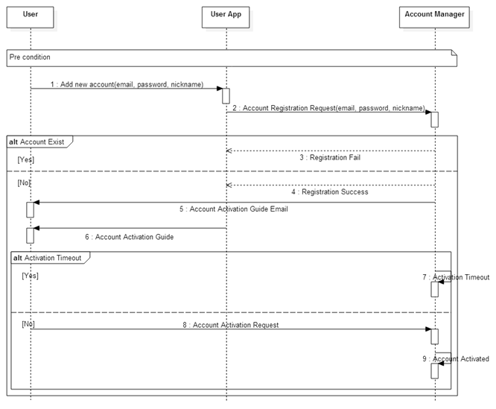
Appendix E - Sequence Diagram (Make New Account)

Slide 34
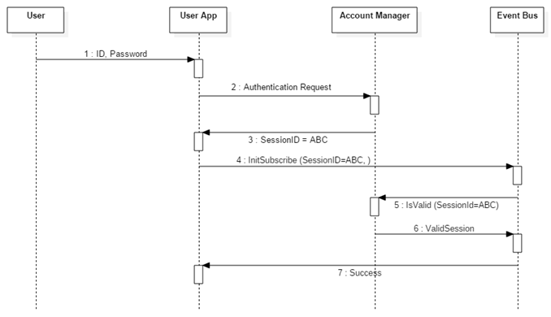
Appendix E - Sequence Diagram (Login)
Sequence diagram how to Check Valid User (QA01 Security)

Slide 35
Appendix F - Status Diagram of User View
App Start
Choose Node List
Welcome
Enter
Login Info
SA node List and System Config
Choose
SA node
SA node Status
Choose
Actuator
SA node Control
Choose
Node List
Choose
Node Status
Choose
Make
account
Enter
New Value
Choose
Welcome
Choose
Reg./Unreg
Choose
Config
Choose
Log view
Make Account
Register/Unregister SA nodes
Log Config
View Log
Notification (Alarm or Information)
Choose Node List
Legend (Dynamic Behavior)
Status of View
User Input – enter some kinds of data
Receive alarm message
User Input – choose one item

Slide 36
Appendix G – QA Scenario (1/5)
Security |  | ID: QA01
Quality Attribute: Hackers or ill minded people try to break into the system. When unauthorized user attempts to login to the system, the system maintains the audit trail. If the attempt is repeated more than 5 times, the account is locked, and the source of tempering is identified.
Stimulus | Login attempt with an Incorrect id or a password
Source(s) of the stimulus | Human or machine
Relevant environmental conditions | Normal operation
Architectural elements | System
System response | The system bans any further access, and logs all access attempts.
Response measure(s) | Five repeated attempts locks the account, and the source of tempering is identified.

Slide 37
Appendix G – QA Scenario (2/5)
Security |  | ID: QA02
Quality Attribute: Hackers or ill minded people try to register the SA node that is not owned by them. When unauthorized user attempts to register the SA node that he/she doesn’t own, the system maintains the audit trail, and cancel the registration in 10 minutes.
Stimulus | Unauthorized SA node registration
Source(s) of the stimulus | Human or machine
Relevant environmental conditions | Normal operation
Architectural elements | System
System response | The system prevents the registration of SA node of which ownership is not identified.
Response measure(s) | Undefined SA node registration is canceled in 10 minutes.

Slide 38
Appendix G – QA Scenario (3/5)
Availability |  | ID: QA03
Quality Attribute: SA node can crash, hang, or be disconnected from the network for various reasons. If SA node is inoperable or out of reach, the system should be aware of such events, and notify user within 1 minutes.
Stimulus | SA node failure
Source(s) of the stimulus | SA node
Relevant environmental conditions | Normal operation
Architectural elements | System, SA node
System response | The system monitors and detects the failure of SA node.
Response measure(s) | System notifies failure to user within 1 minutes.

Slide 39
Appendix G – QA Scenario (4/5)
Modifiability |  | ID: QA07
Quality Attribute: The system should make it easy to add emerging SA node protocols (eg. Bluetooth 802.15, ZigBee 802.15.4) to the system. Average skilled developers should be able to implement it within two months.
Stimulus | New protocols for SA node
Source(s) of the stimulus | Developer
Relevant environmental conditions | After release
Architectural elements | System, SA node
System response | New protocols is supported by the system and SA node.
Response measure(s) | Average skilled developers can implement it within two months.

Slide 40
Appendix G – QA Scenario (5/5)
Extensibility |  | ID: QA09
Quality Attribute: The system should make it easy for application developers (private persons, VARs, or other 3rd parties) to build custom apps, services, and/or make mashups from existing available services. Average skilled developers should be able to build the application in six months.
Stimulus | New application or service
Source(s) of the stimulus | Developers (including 3rd party), VARs
Relevant environmental conditions | After release
Architectural elements | System
System response | The system supports the new application/service.
Response measure(s) | Average skilled developers should be able to build the application in six months.

